Slide 1
AI and creativity
AI for Business

Slide 2
Introduction
Visualization in Statistics and Machine Learning…
… is a methodology that allows for discovering or confirming a useful information about the data by constructing and examining the graphical output
Course contents
Topic 1: Introduction to Data Visualization. Introduction to Ggplot2, Plotly, Shiny.
Topic 2: Perception and Visualization. Data preprocessing.
Topic 3: Basic graphs. Geospatial visualization.
Topic 4: Multivariate data visualization.
Topic 5: Interactive visualization. Text visualization.
Topic 6: Graph visualization. Animation.
732A98 Visualization

Slide 3
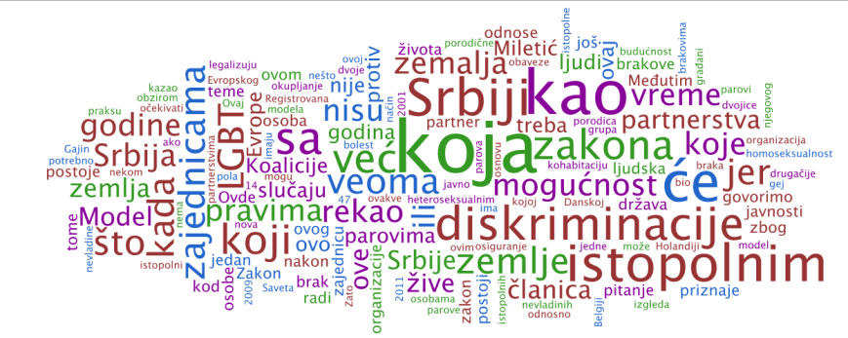
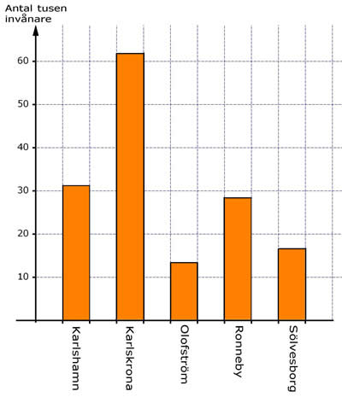
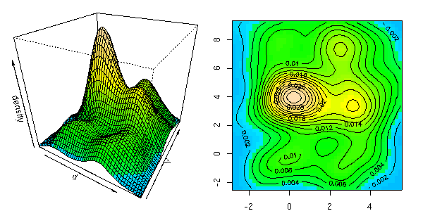
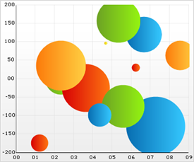
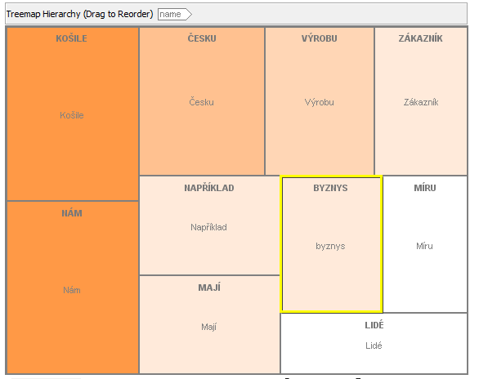
Viualizations
732A98 Visualization

Slide 4
Different types of visualization
Focus on visualization=information visualization
Data→Visualization→Analysis
Related concepts
Computer graphics: Data are not necessary present, analysis is not normally assumed
Example: Computer games
Scientific visualization: similar to information visualization, often engineering data, statistical/machine learning analysis is normally not assumed
Example: Industrial robots
732A98 Visualization

Slide 5
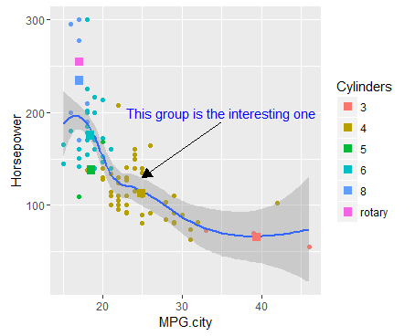

Different types of visualization
https://www.youtube.com/watch?v=mpechGIfPbw
Scientific visualization
Information visualization
732A98 Visualization

Slide 6
Challenges in information visualization
Which graphs can be used for analysis of my data?
How to create these graphs?
How should these graphs be analysed?
How to make these graphs looking good enough for publication or presentation?
732A98 Visualization

Slide 7
Why is visualization important?
Human sight = primary resource for information understanding
Visualization is often the quickest way for data understanding
The way of data visualization may affect decision making dramatically
732A98 Visualization

Slide 8
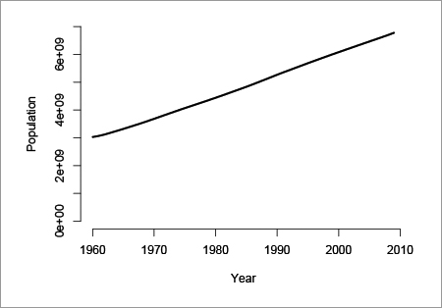
Why is visualization important?
Decision here: population does not increase so much, no intervention needed
Decision here: population increases quickly, intervention is required
Visual perception problem
732A98 Visualization

Slide 9
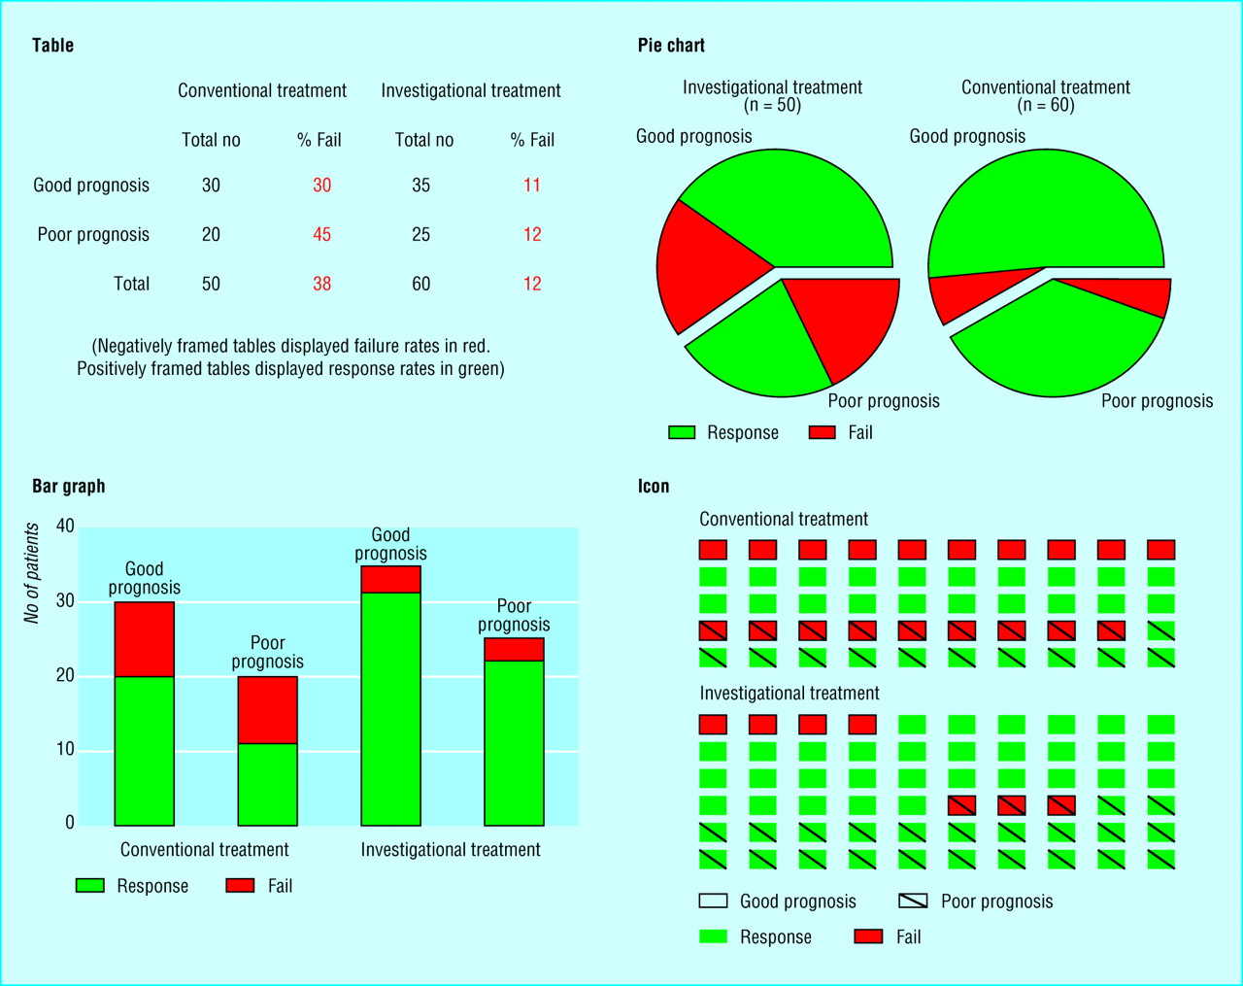
Why is visualization important?
Source: Elting Linda S, Martin Charles G, Cantor Scott B, Rubenstein Edward B. Influence of data display formats on physician investigators' decisions to stop clinical trials: prospective trial with repeated measures BMJ 1999; 318 :1527
732A98 Visualization

Slide 10
Visualization aims
Visualization for exploration
Clusters
Trends
Anomalies
…
Confirmatory visualization
Example 1: Perform linear regression, analyse residuals→ was linear regression reasonable
Example 2: Discover clusters by K-means, visualize clusters→ are they clusters actually?
Visualization for presentation
732A98 Visualization

Slide 11
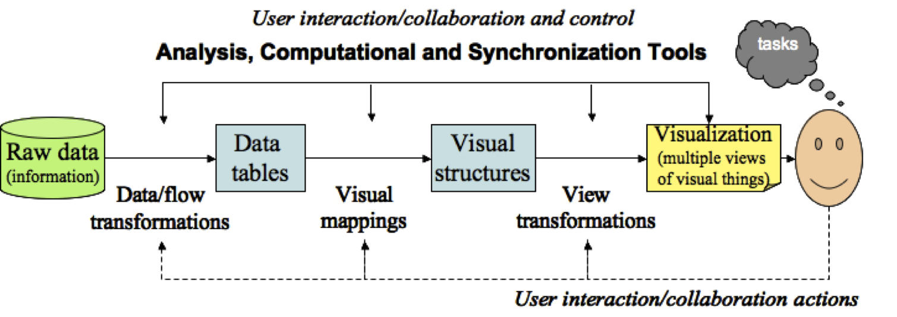
Visualization pipeline
Key ingredient: mapping data columns to visual structures (aesthetics)
732A98 Visualization

Slide 12
The role of perception
Human visual system has limitations
These limitations may lead to wrong/incomplete analysis of graphs
Understanding how we see→ better displays
Misleading graphics needs to be avoided
732A98 Visualization

Slide 13
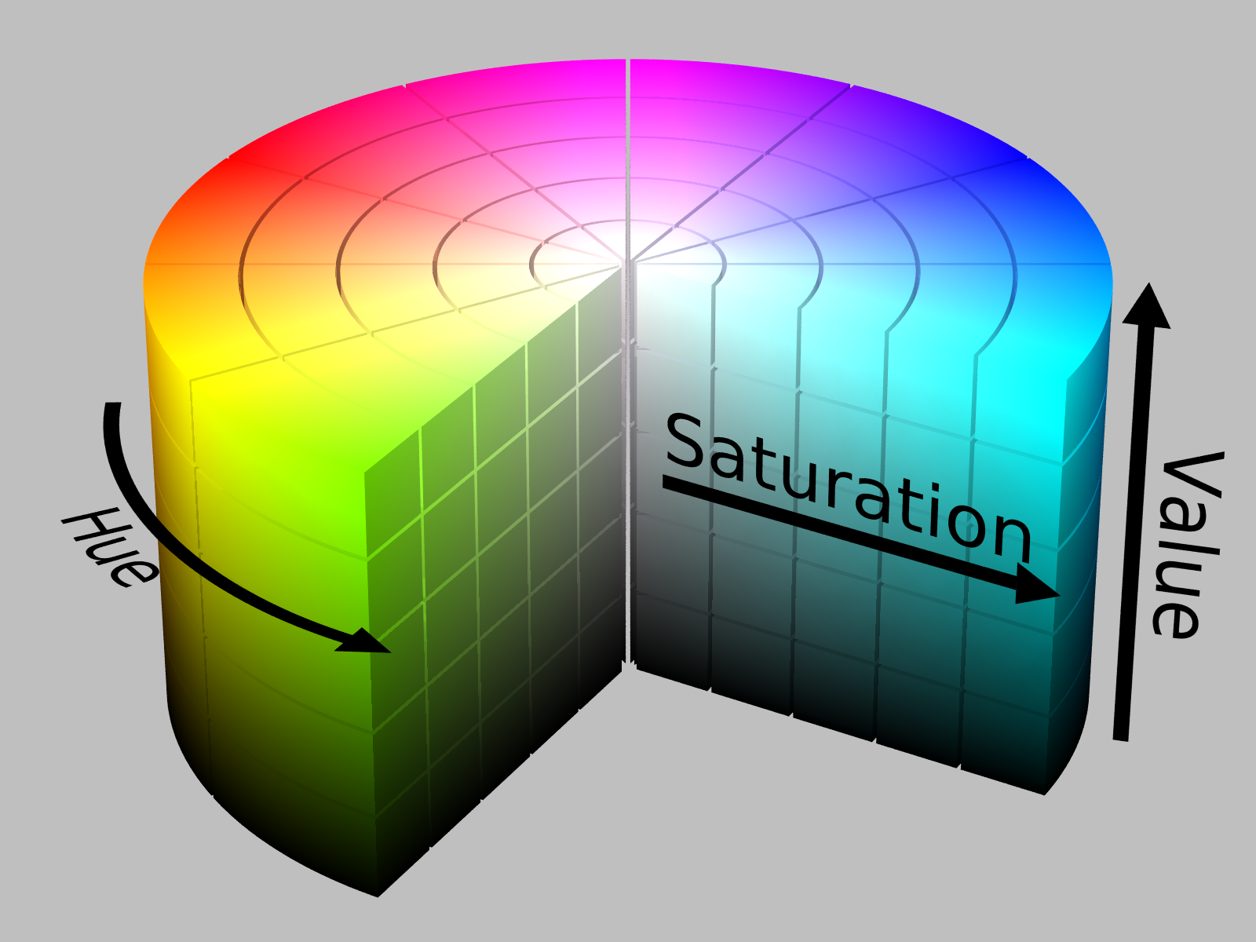
Colors
Color= hue + saturation + value (lightness)
8% of males are color deficient→ what are good colors?
https://henrydangprg.com/2016/06/26/color-detection-in-python-with-opencv/
732A98 Visualization

Slide 14
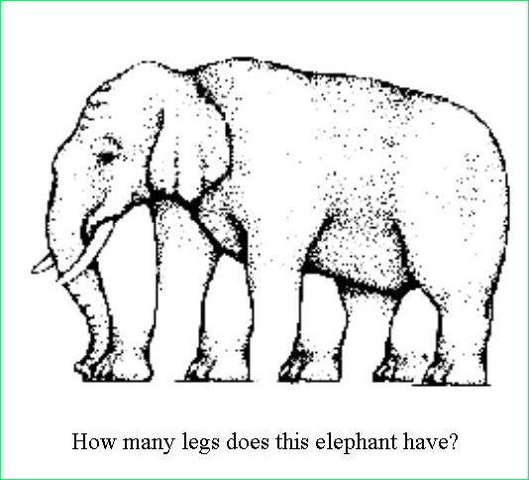

Illusions
http://www.ilusa.com/gallery/elephant-illusion.jpg

Slide 15
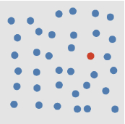
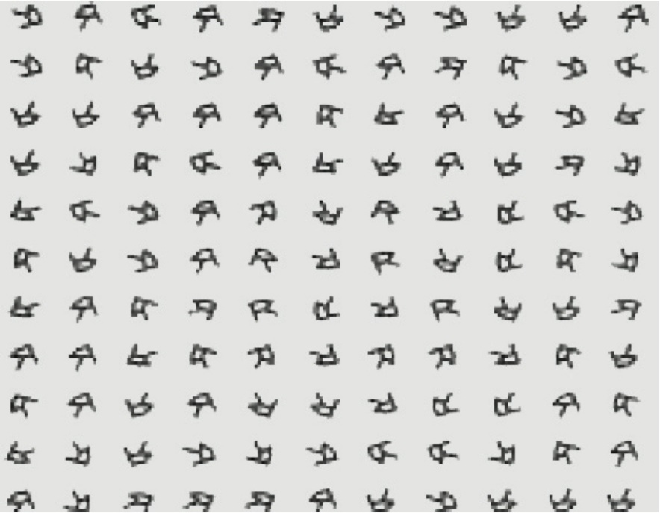
Preattentive processing
Certain aesthetics are fast to process
How quickly can you identify a red dot?
How quickly can you identify a square of right-handed Rs?
732A98 Visualization

Slide 17
The role of perception
How can this affect analysis?

Slide 18
Data preprocessing
Viewing raw data is often prefered
Sometimes some preprocessing is needed
Missing values and Data cleaning
Discard the bad record →may remove almost all data
Assign sentinel value
Column mean imputation
Nearest neighbor imputation
Other imputations
732A98 Visualization

Slide 19
Data preprocessing
Normalization
Converting column to range [0,1]. Useful in for ex. color mapping
Centering and scaling 0/1
Nonlinear transformations: log, sqrt
Segmentation
Split data according to some column
732A98 Visualization

Slide 20
Data preprocessing
Sampling, subsetting and expanding
Random sampling reduces size of data and facilitates overplotting (for ex. scatterplots)
Interpolation: linear (one dimension), bilinear (two dimensions), nonlinear. Select necessary amount of intrepolation points.
Dimension reduction
PCA
MDS
Other techniques (ex. ICA, Autoencoders), welcome to Machine Learning course…
732A98 Visualization

Slide 21
Data preprocessing
Mapping nominal dimensions to numbers
Random mapping should never be done unless intrinsic ordering is present
Use other numeric variables to measure in the data to measure “closeness” of values in the nominal variable
Correspondence analysis
Aggregation and summarization
Grouping observations
Computing summary statistics per group
732A98 Visualization

Slide 22
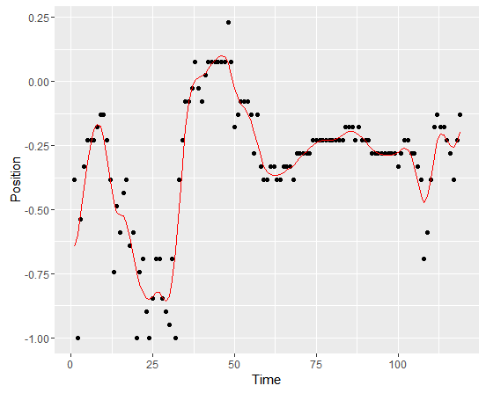
Data preprocessing
Smoothing and filtering
Replace original values with a smoothed versions
732A98 Visualization

Slide 23
Software
Commercial:
SAS and SAS JMP – environment. Special visual tools are available (JMP), require separate license. Well documented. Good even for large sets. SAS Enterprise Guide has many visual static tools
Spotfire – Many static and interactive visualization tools
Tableau– Many static and interactive visualization tools
InfoScope – visualizing maps, interactive visualizations
Free:
R – programming language. Set of packages is constantly updated. A lot of statistical tools (even the newest methods) Badly documented
Plotly – a tool for interactive and dynamic graphics, R interface available
Shiny - – a tool for R-based web applications using graphics
GraphViz – visualization of graph data, coding needed
Jigsaw – Text analysis
732A98 Visualization

Slide 24
Software
Tools for the web (used by web designers):
ActionScript
JavaScript
Prefuse
VTK
… much more references given in the course book
732A98 Visualization

Slide 25
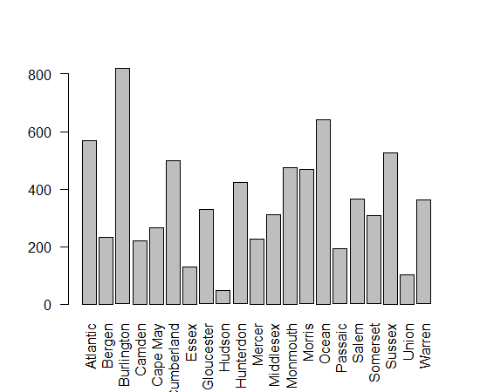
Graphical tools in R
R base: basic plotting, not publication quality
Grob package: low-level plotting tools, new types of plots
Zhou, Lutong, and W. John Braun. "Fun with the r grid package." Journal of Statistics Education 18.3 (2010).

Slide 26
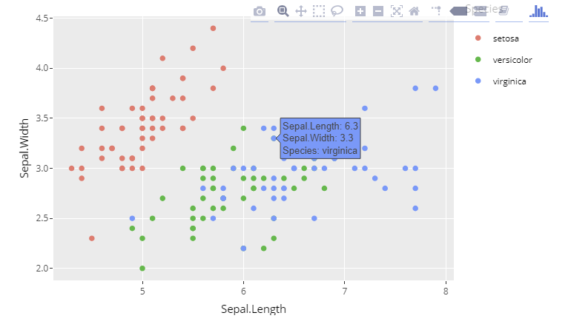
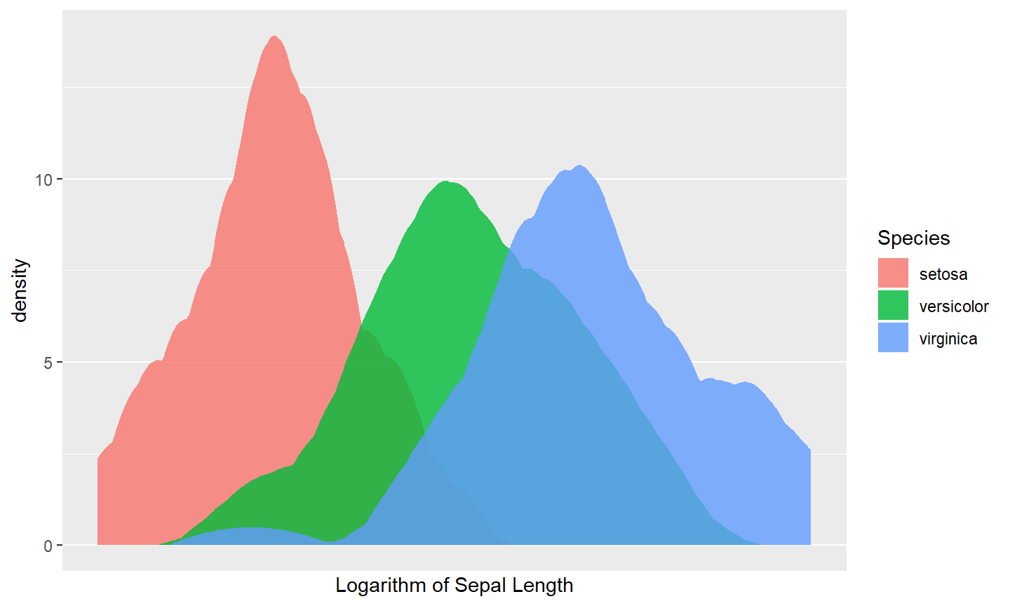
Graphical tools in R
Ggplot2 package: based on grammar of graphics, close to publication quality
Plotly package: Ggplot2 + interactivity

Slide 27
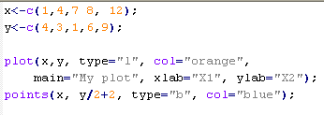
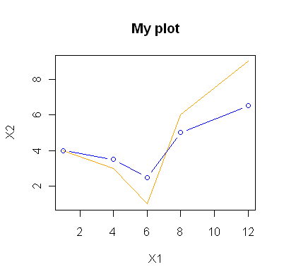
Graphical procedures
Base R graphical procedures:
plot(x,..) plots time series
plot(x,y) scatter plot
plot(x,y) followed by points(x,y) plots several scatterplots in one coordinate system
hist(x,..) plots a hitogram
persp(x,y,z,…) creates surface plots
cloud(formula,data..) creates 3D scatter plot
732A98 Visualization

Slide 28
Publication quality graphics
Visualization for exploration
Default settings
Visualization for presentation for publication
Higher quality graphics is required
Improve the graph quality in the software (often requires quite a bit of programming)
Use postprocessing tools, such as Inkscape or Adobe Illustrator

Slide 29
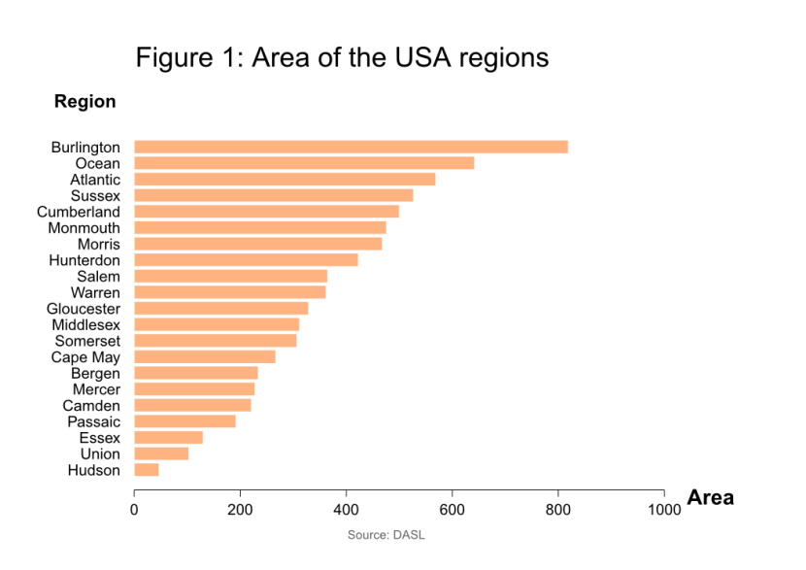
Publication quality graphics
Plot processed in Inkscape
Example: Compare two plots and state what is improved in the second plot.

